Slide 1
EMI Noise Prediction
Furkan Tokgöz

Slide 2
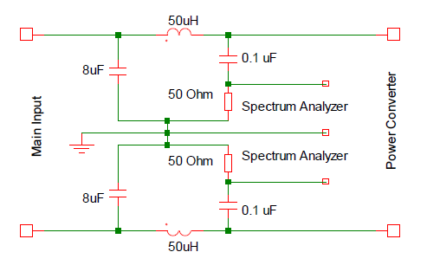
Measurement of the Noise
Line Impedance Stabilization Network (LISN)
Fig.1. LISN circuit schematic [1]

Slide 3
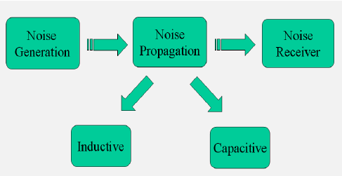
Modelling
Fig.2. EMI mechanism [2]

Slide 4
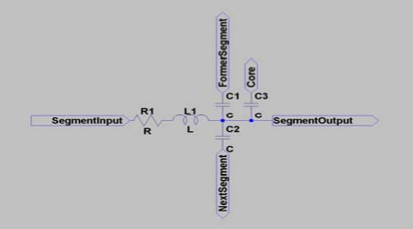
Inductor Modelling
Fig.3. Equivalent circuit of inductor for one segment [3]

Slide 5
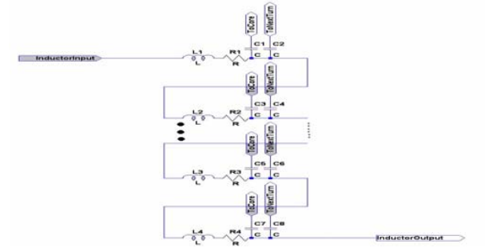
Inductor Modelling
Fig.4. Complete model for an inductor [3]

Slide 6
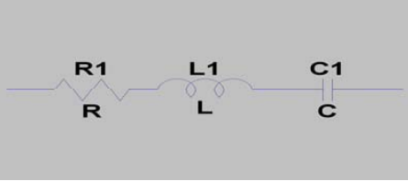
Capacitor Modelling
Fig.5. Equivalent circuit for capacitors [3]

Slide 7
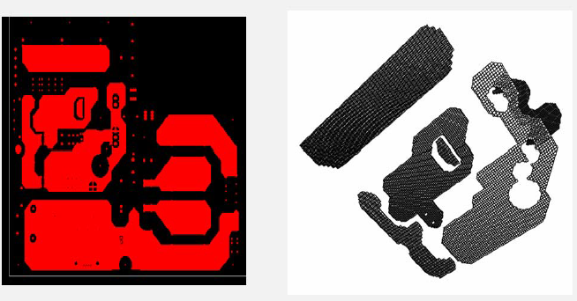
PCB Modelling
Partial Element Equivalent Circuit (PEEC)
Fig.6. PCB layout and its PEEC model [2]

Slide 8
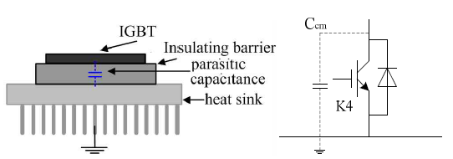
Parasitic Capacitance Modelling
Fig.7. Heatsink parasitic capacitance modelling [4]

Slide 9
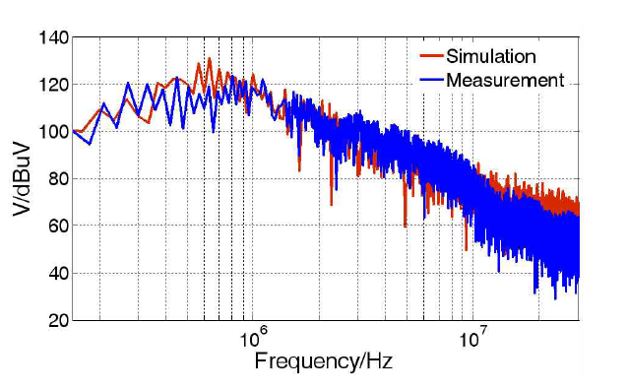
Simulation
Fig.8. Compared noise results [4]

Slide 10
References
Design and implementation of EMI filter for high frequency (MHz) power converters, A.Majid, J.Saleem
Prediction of Conducted EMI in Power Converters Using Numerical Methods, Junsheng Wei
Simulation and Modelling of Power Passive Components for EMI Prediction, Junsheng Wei
Common Model EMI Prediction in Motor Drive System for Electric Vehicle Application, Yong-Ming Yang

